Slide 1
A Protein-ligand Docking Function Webserver With Heat Map Result Visualization
Presenter: Yuexin Yu
Professor: Nicholas Provart
2020. 03.

Slide 2
Agenda
Background
Workflow and results
Future Outlook

Slide 3
Background
Protein – ligand docking
Protein <- receptor
Ligand <- small molecules <- hormone & sugar
Docking <- Rigid body docking <- Hex

Slide 4
Background
Ligands (small molecules)
Why they are important?
Regulate plant development, physiology, and metabolism
Since they are important,
Potential regulatory modes (e.g. off-target effects, novel targets)

Slide 5
Background
Docking
Analyse the action of small molecules in the binding site of a target protein
Rigid body docking VS flexible docking
Current program: HEX

Slide 6
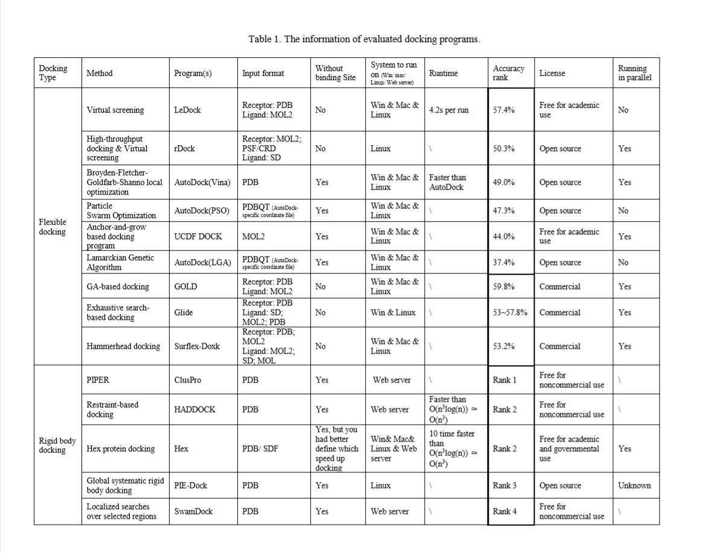
Table 1. The table of the comparison of protein-ligand and protein-protein docking servers in different methods. The data for accuracy ranking is supported by the review from Pagadala Lab (Pagadala NS et al. 2017) and the test by Wang Lab (Wang Z et al, 2016). Other information is from user manual or web user guide for each docking programs.

Slide 7
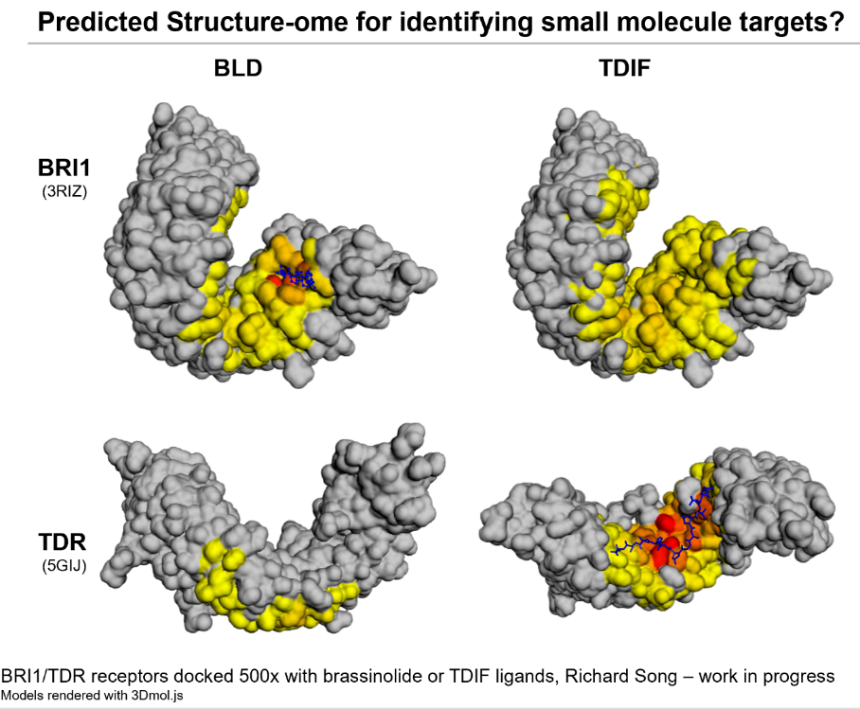
Idea was from …
Figure 1. The visualization version from Richard of BRI1/TDR receptors docked 500x with brassinolide or TDIF ligands.

Slide 8
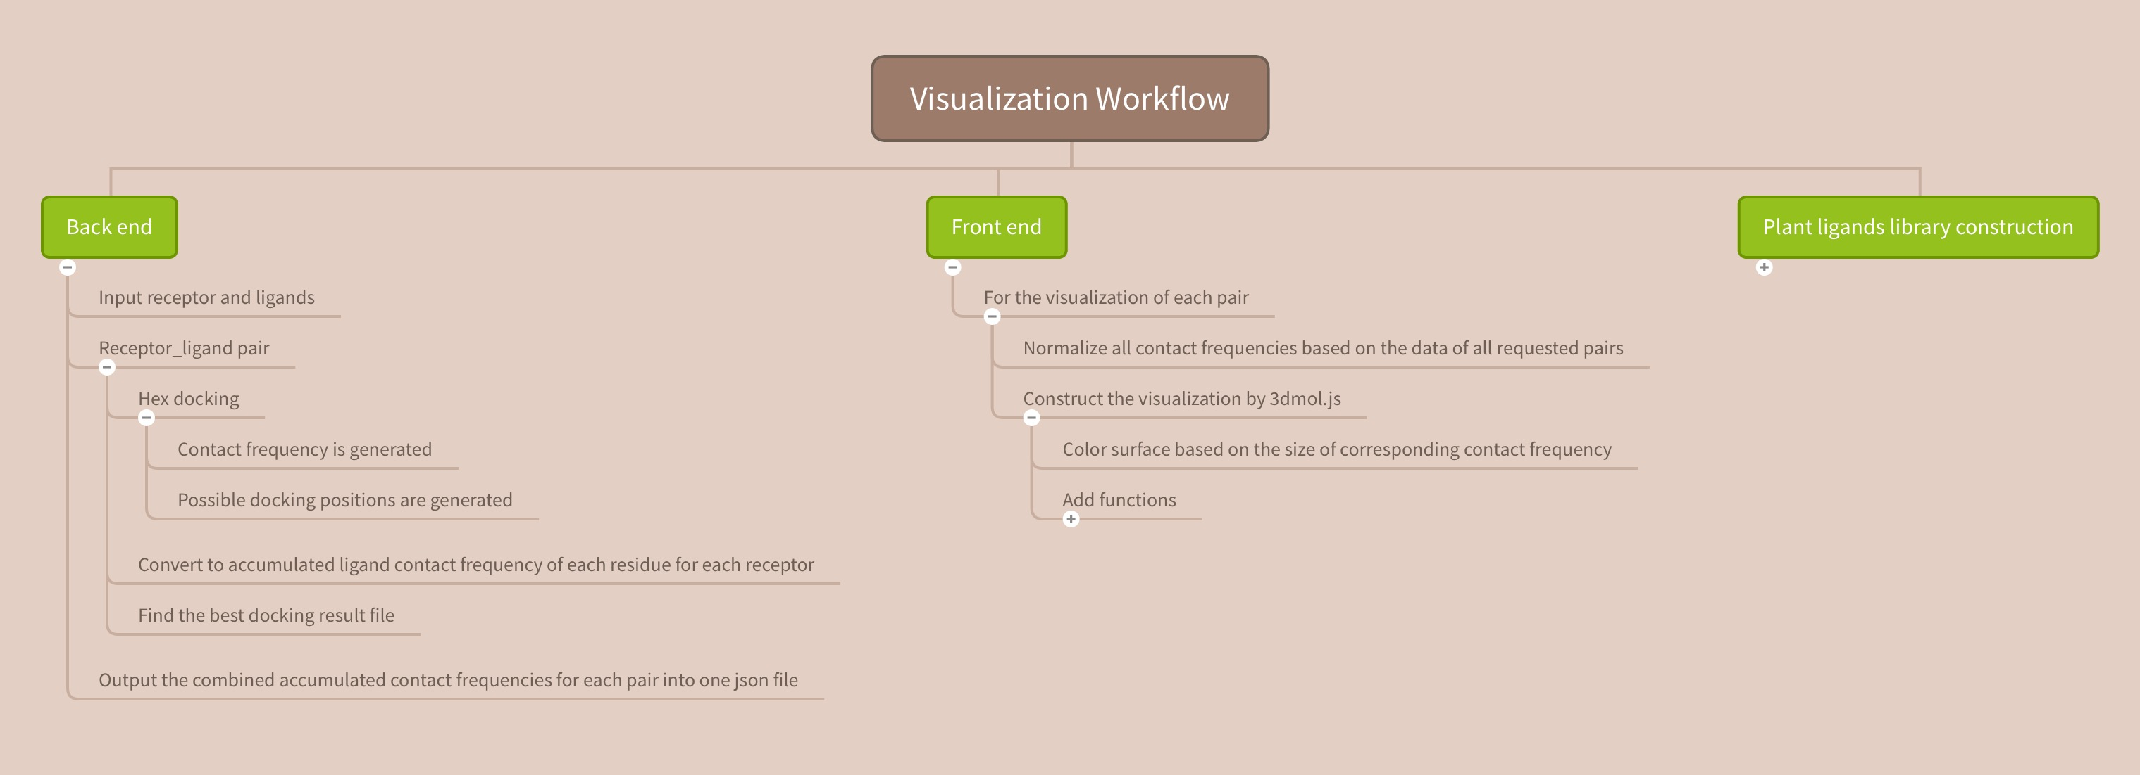
Workflow
Workflow
Figure 2. The general workflow of how to achieve the visualization from back end to front end as well as the construction of plant ligands library.

Slide 9
e.g.
Receptor list: 3RIZ, 5GIJ
Ligand list: BLD, TDIF
Receptor_ligand pair:
3RIZ_BLD, 3RIZ_TDIF, 5GIJ_BLD, 5GIJ_TDIF
Output json file:
Accumulated contact frequencies for 3RIZ_BLD, 3RIZ_TDIF, 5GIJ_BLD, and 5GIJ_TDIF
The language used in back end is Python.
Figure 3. The workflow of back end of the visualization project.

Slide 10
The language used in the front end is HTML and Java script. 3Dmol.js is imported to build the visualization of 3D structure. Bootstrap is used as the layout format.
Figure 4. The workflow of front end of the visualization project.

Slide 11
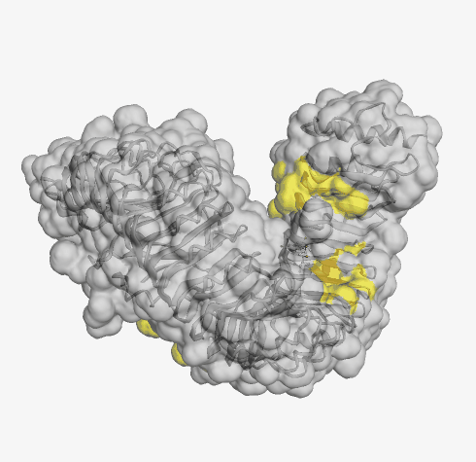
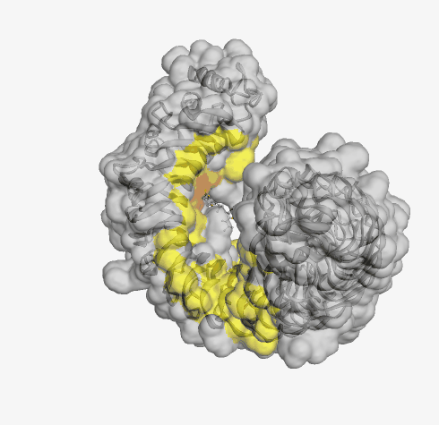
Example is from the visualization of 3RIZ and BLD pair
Receptor in cartoon style
Ligand in ball and stick style
Figure 4. The workflow of front end of the visualization project.

Slide 12
Example is from the visualization of 3RIZ and BLD pair
Figure 4. The workflow of front end of the visualization project.

Slide 13
Figure 4. The workflow of front end of the visualization project.

Slide 14
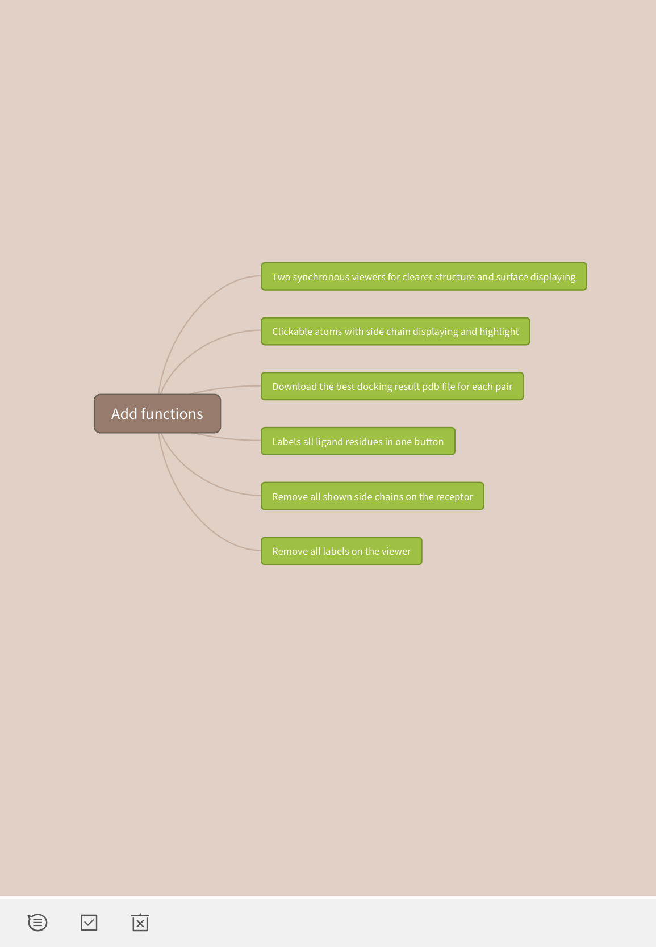
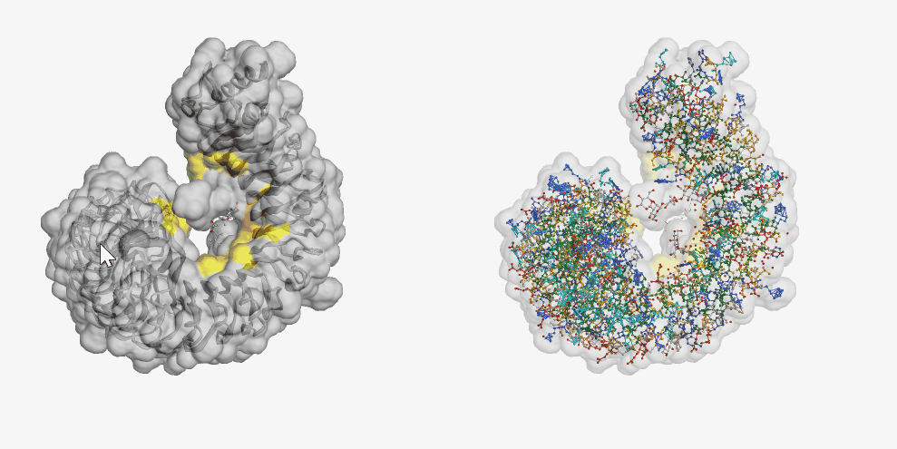
Example is from the visualization of 3RIZ and BLD pair
Figure 5. The chart of functions of the visualization project.

Slide 15
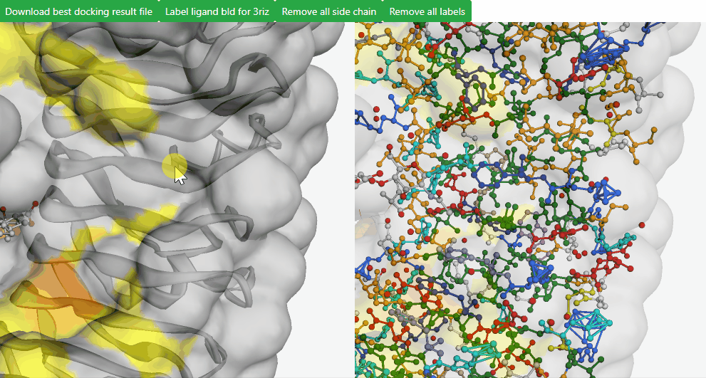
Example is from the visualization of 3RIZ and BLD pair
Figure 5. The chart of functions of the visualization project.

Slide 16
Example is from the visualization of 3RIZ and BLD pair
Figure 5. The chart of functions of the visualization project.

Slide 17
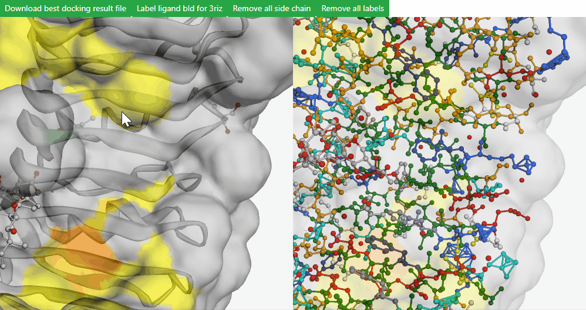
Example is from the visualization of 3RIZ and BLD pair
Figure 5. The chart of functions of the visualization project.

Slide 18
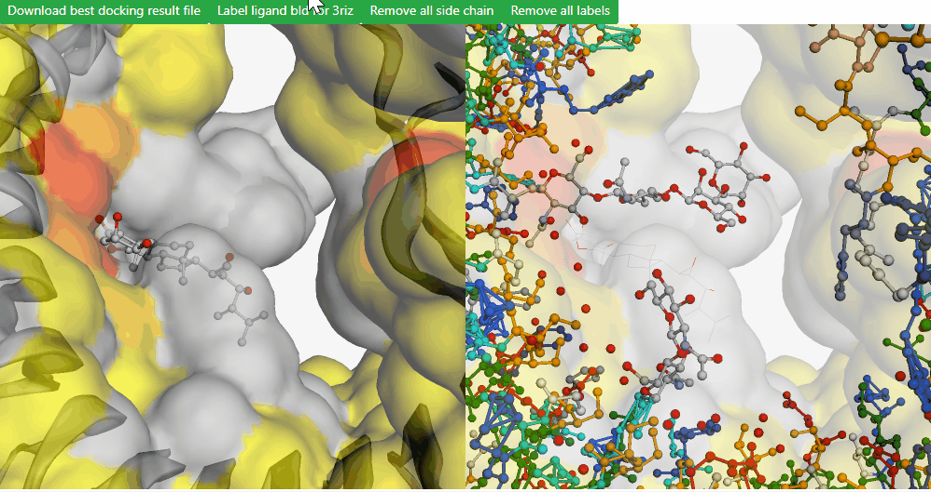
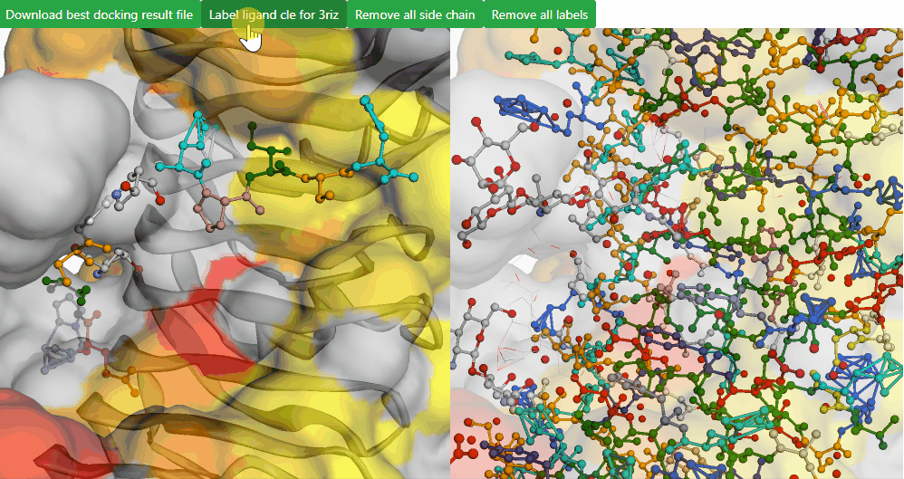
Example is from the visualization of 3RIZ and BLD pair
Example is from the visualization of 3RIZ and CLE pair
Figure 5. The chart of functions of the visualization project.

Slide 19
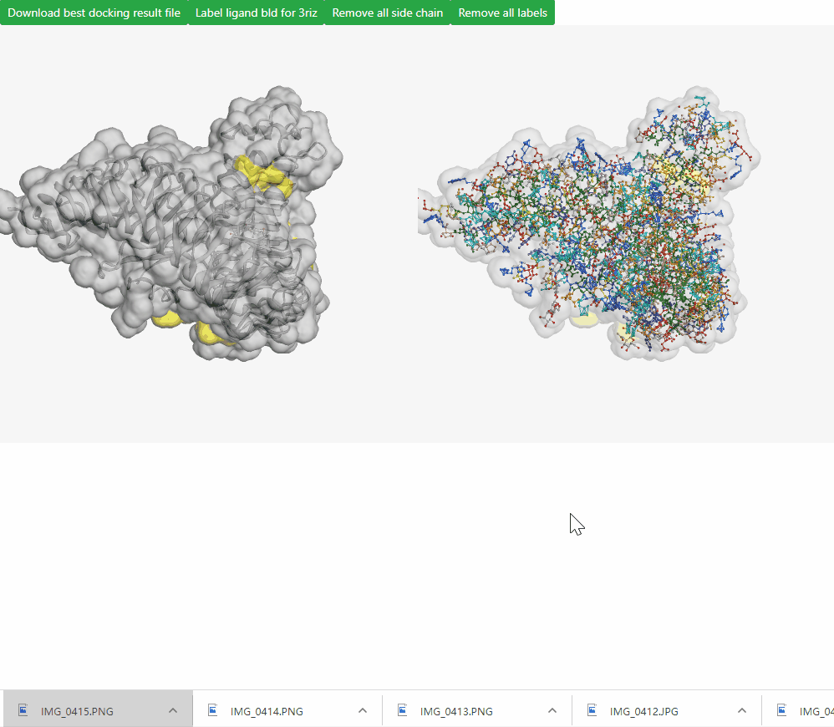
Figure 5. The chart of functions of the visualization project.
Example is from the visualization of 3RIZ and BLD pair

Slide 20
Figure 5. The chart of functions of the visualization project.
Example is from the visualization of 3RIZ and BLD pair

Slide 21
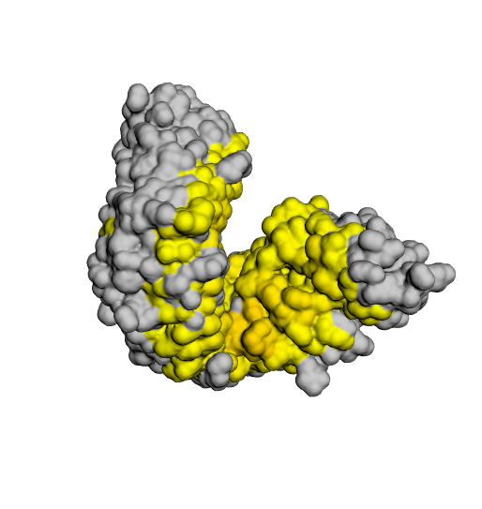
Correction proof
BLD
TDIF
BRI1
(3RIZ)
TDR
(5GIJ)
Figure 6.
BRI1/TDR receptors docked 500x with brassinolide or TDIF/cle ligands.
Models rendered with 3Dmol.js
Figure 7.
The visualization version from Richard of BRI1/TDR receptors docked 500x with brassinolide or TDIF ligands

Slide 22
Application

Slide 23
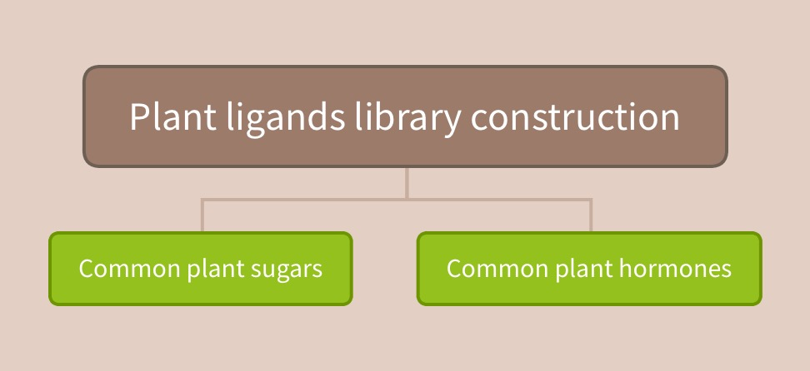
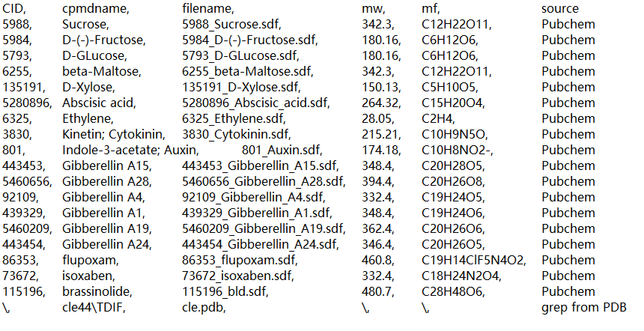
Figure 8. The chart of ligand categories in constructed plant ligand library.
Figure 9. The screenshot of the look-up table for plant ligand library

Slide 24
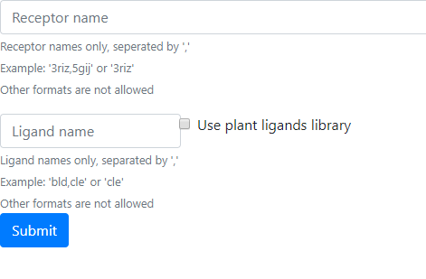
Future Outlook
Dynamic web generation
Connect the front end and back end
Available to dock a given receptor to the whole plant ligand library
Notification of completion
Back end

Slide 25
Reference
Pagrada
Wang Z, et al. 2016. Comprehensive evaluation of ten docking programs on a diverse set of protein–ligand complexes: the prediction accuracy of sampling power and scoring power. Phys. Chem. Chem. Phys. 18:12964-75

Slide 26
Thanks for listening

