Slide 1
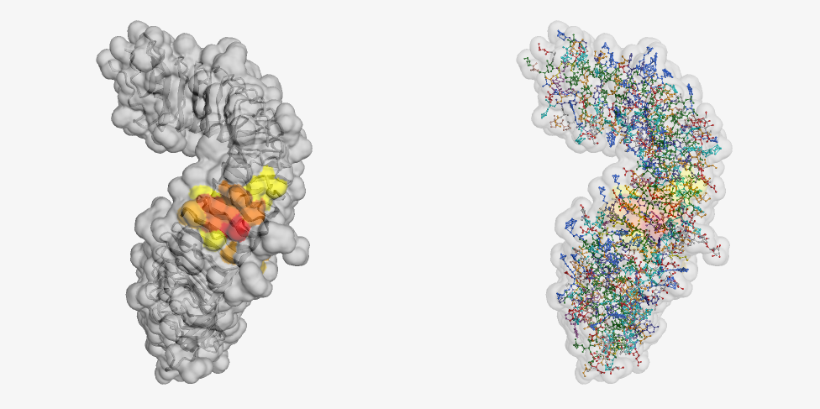
CSB497H1: Independent Research Project Presentation
Topic: Development of a multimer compatible web-based protein docking application
Presented by: Metyu Melkonyan
Supervised by Prof. Nicholas Provart, Vincent Lau M. Sc., Ph.D. candidate Carlo Perolo

Slide 2
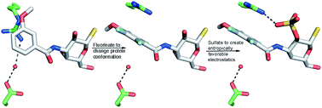
Background Information on Protein and Protein-Ligand Interaction
Proteins
Building Blocks of Life
Metabolism, mechanical support, energy source, signalling molecule
Interacts with a wide variety of molecules such as ligands (Affinity)
Non-covalent interactions such as hydrogen bonds, hydrophobic interactions, π-stacking
Figure illustrating protein-ligand interaction and conformational changes on the protein(A.L. Noresson et al, 2010)

Slide 3
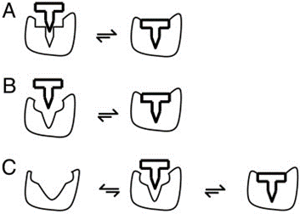
Figure of Lock-and-key (A), Induced-fit (B), Conformational selection (C) (Tobi & Bahar, 2005)
Protein Docking
Protein docking is seen mostly among proteins that are used as a signalling molecule or a receptor
It is an important concept and was described with different models (Specificity)
Each model predicts different binding type

Slide 4
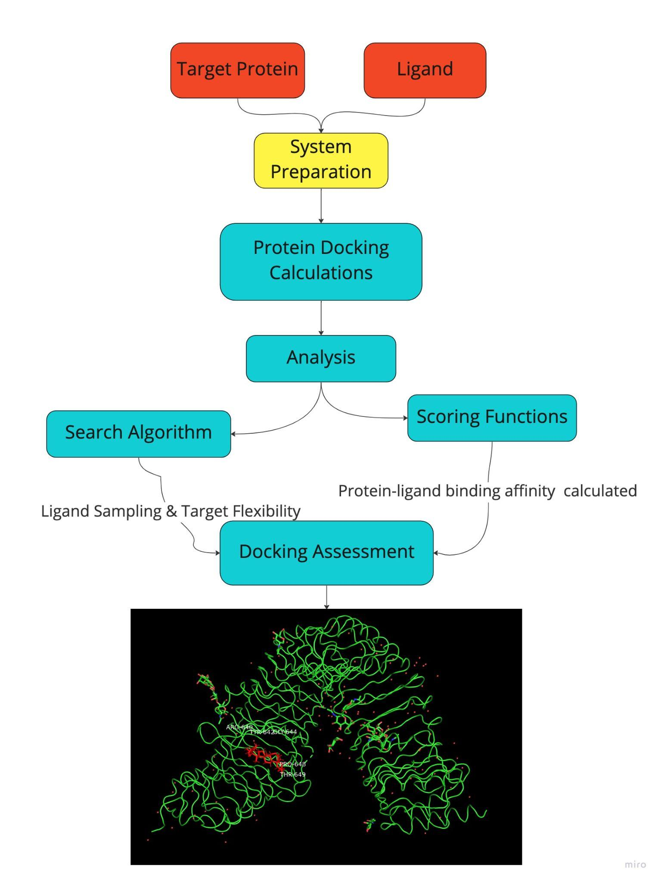
Figure illustrating process of protein docking software, the result was generated by me using a multimer compatible docking script being developed
Why Protein Docking ?
Protein docking is critical to analyze for discoveries in drug discovery
Different ways to investigate protein docking
Protein docking simulations (docking software) can allow for important future predictions
Building a realistic docking software is important for efficient protein docking analysis.
Based on protein the protein docking models, different software is created and tested for the protein-ligand interaction analysis

Slide 5
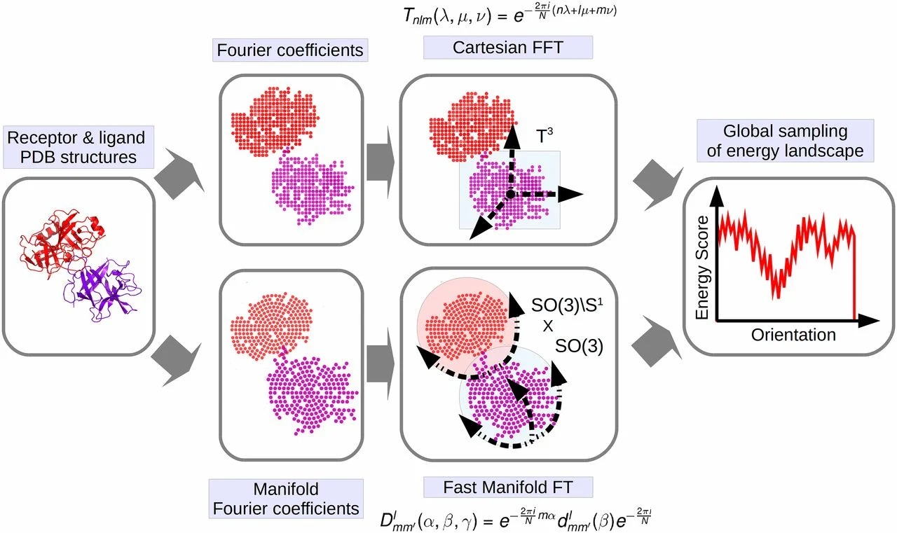
Hex 8.0.0
Developed by Dave Ritchie
FFT-based docking approaches along with Gaussian polynomial
Rigid binding form
Accepting both PDB and SDF files.
Using Cartesian Grid to calculate
Figure illustrating Fast Fourier transform (FFT) docking software process (Padhorny D et al, 2016)

Slide 6
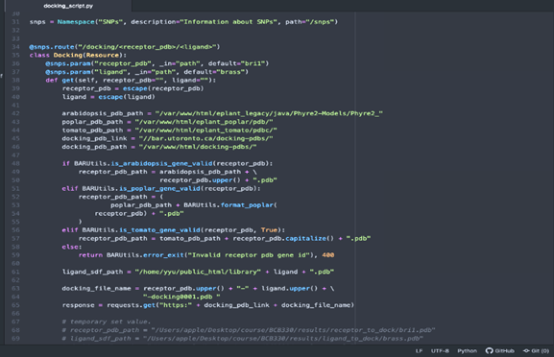
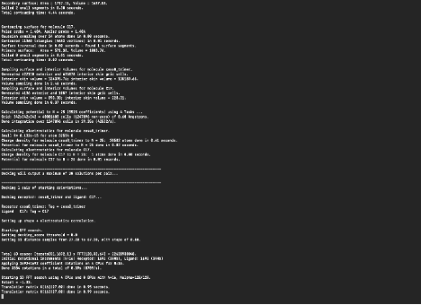
Developing and Implementing Multimer Compatibility on a Web-based Protein-Ligand Application on the BAR API
Figure illustrating a script of a web-based protein docking application
Figure illustrating Running attempts of a script that does not have any GU I
Using docking programs can be challenging due to the required (beginner-intermediate) programming knowledge
No GUI
Also, system version difference

Slide 7
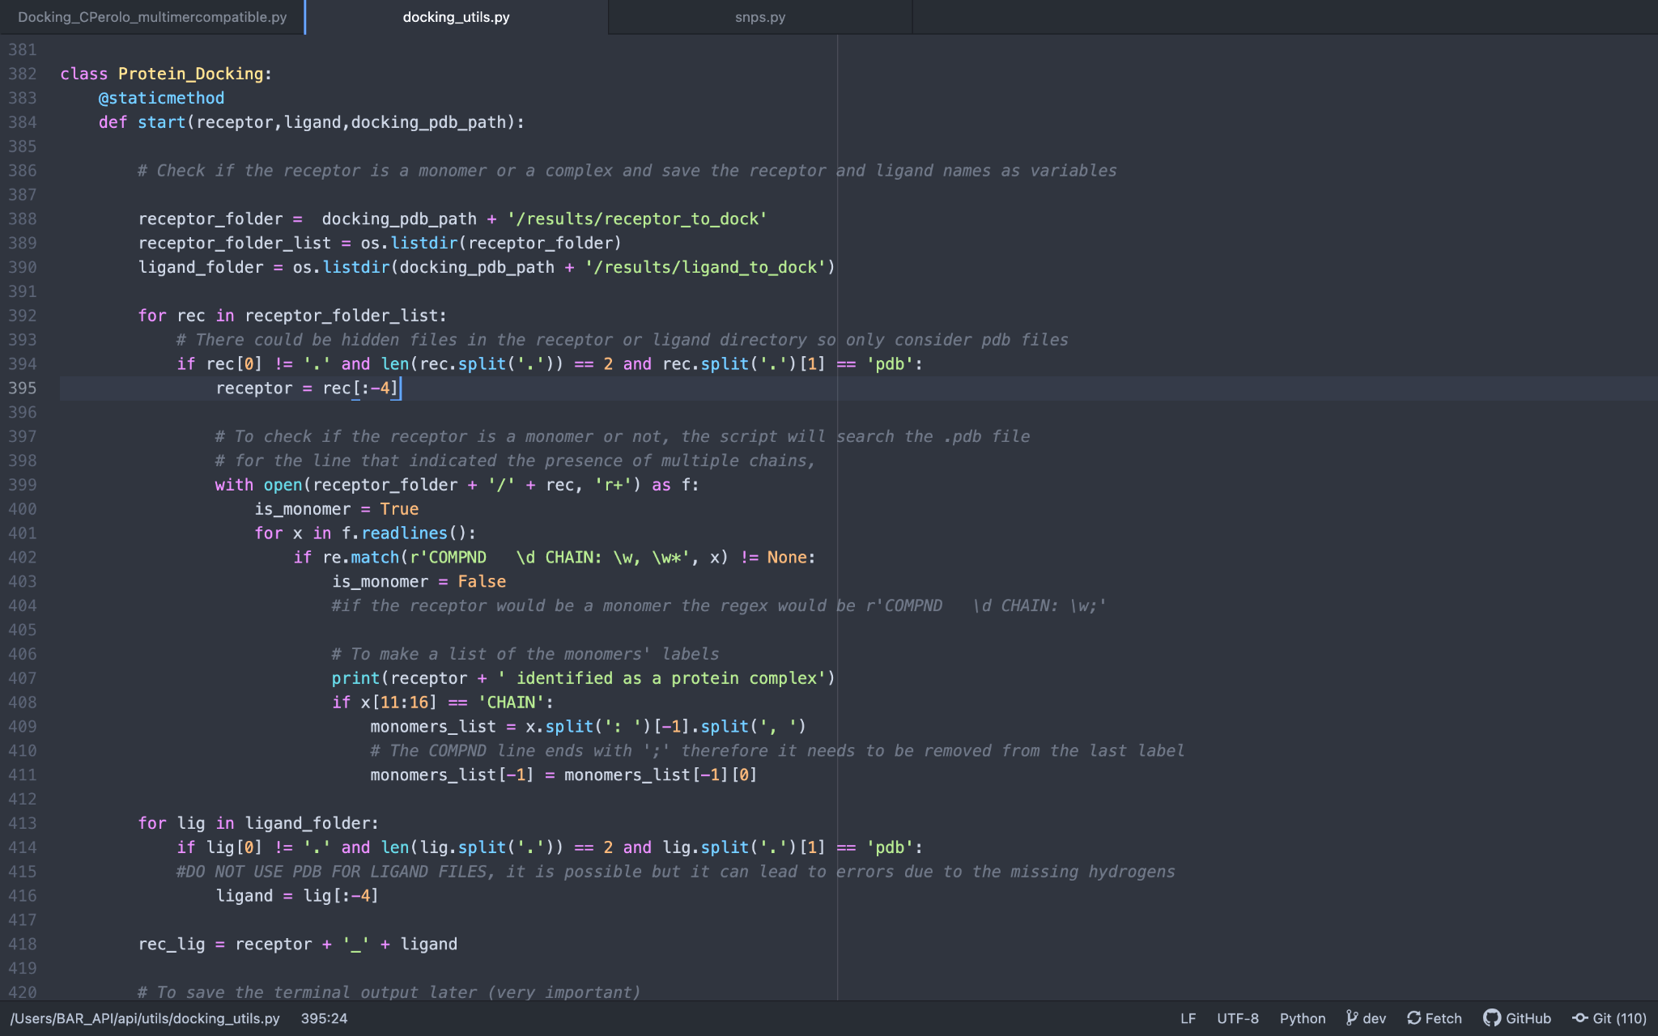
Implementing multimer compatibility
Python 3.0 was used
Written by PhD candidate Carlo Perolo
Modifications were done to make it compatible on working on the BAR server
Different types of protein and ligand were tested
Hex parameters were adjusted based on the protein-ligand interaction strength
Figure illustrating script that allows for analysis of different monomers defined. Further lines allows for normalization of contact frequency containing residue binding energy

Slide 8
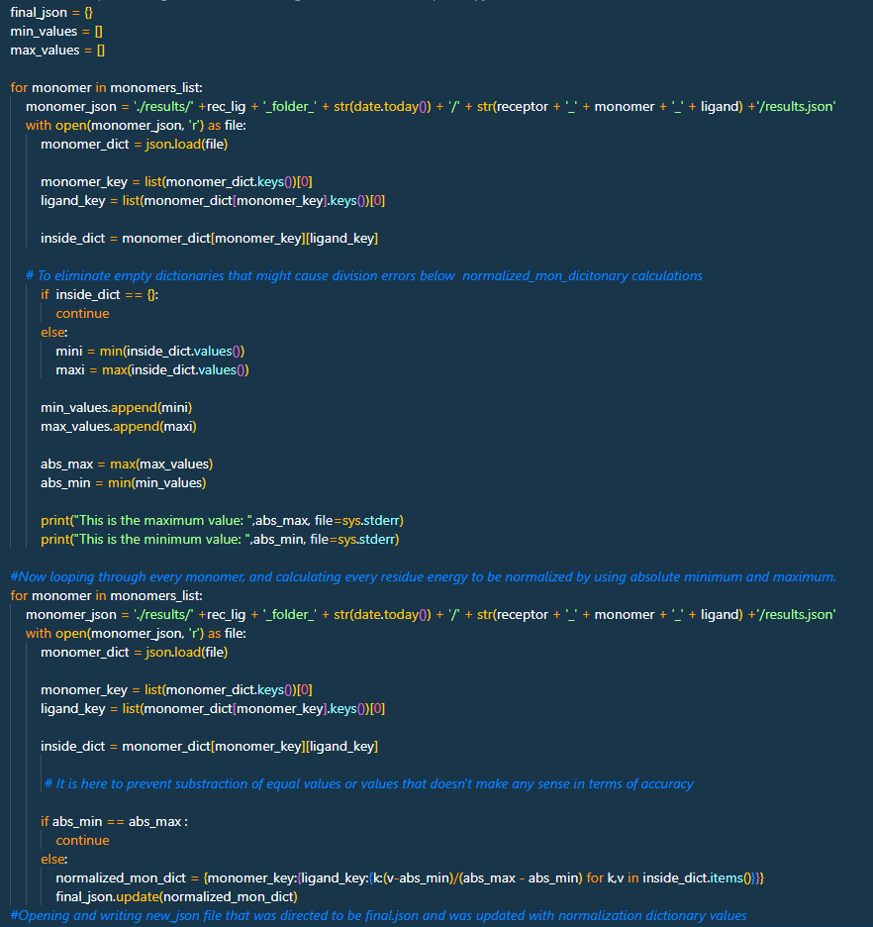
Generating a Heatmap via Normalization
Normalization part was implemented allowing for heatmap generation
Reconfiguration to adapt BAR server directories
Also further modifications were done on the script by both Carlo Perolo and me in regards of different file format recognition
Figure illustrating normalization part that was added to generate a heatmap via normalization of contact frequencies

Slide 9
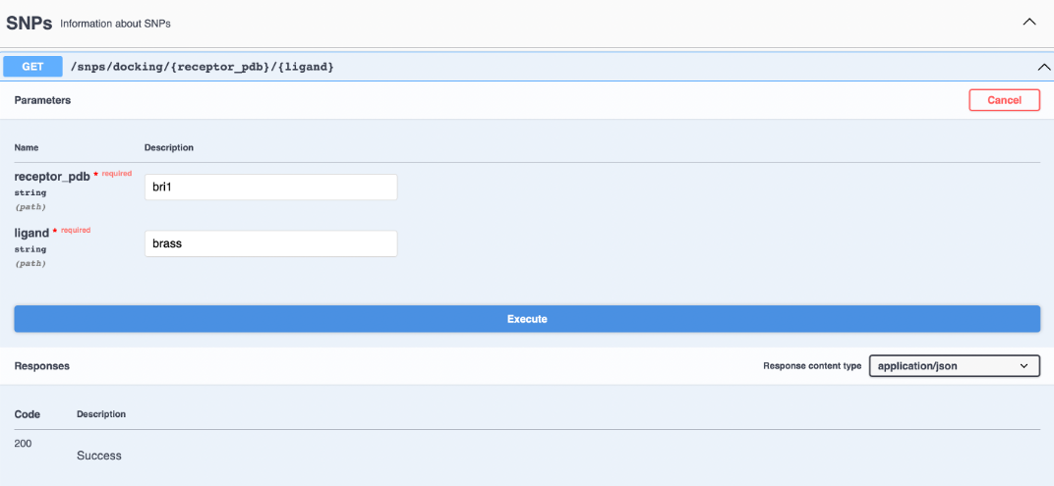
Script Running Process
Local script running
3riz-BLD
3riz-TDIF
5gij-TDIF
5gij-BLD
Results obtained in the local directories
Many proteins and ligands were run to test the script competency as well
Figure illustrating the docking script section on BAR API, using default protein (bri) and ligand (brass)

Slide 10
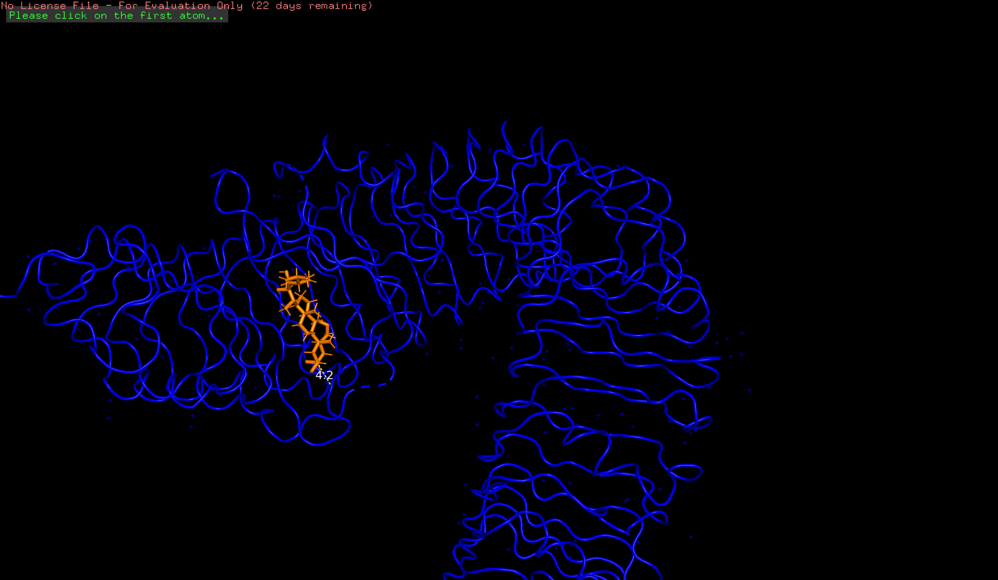
Docking Results
Best docking results o 3riz-BLD , ligand (orange) , receptor (blue)
Best docking results of 6fif-isoxaben, ligand labeled(cyan), receptor(yellow)

Slide 11
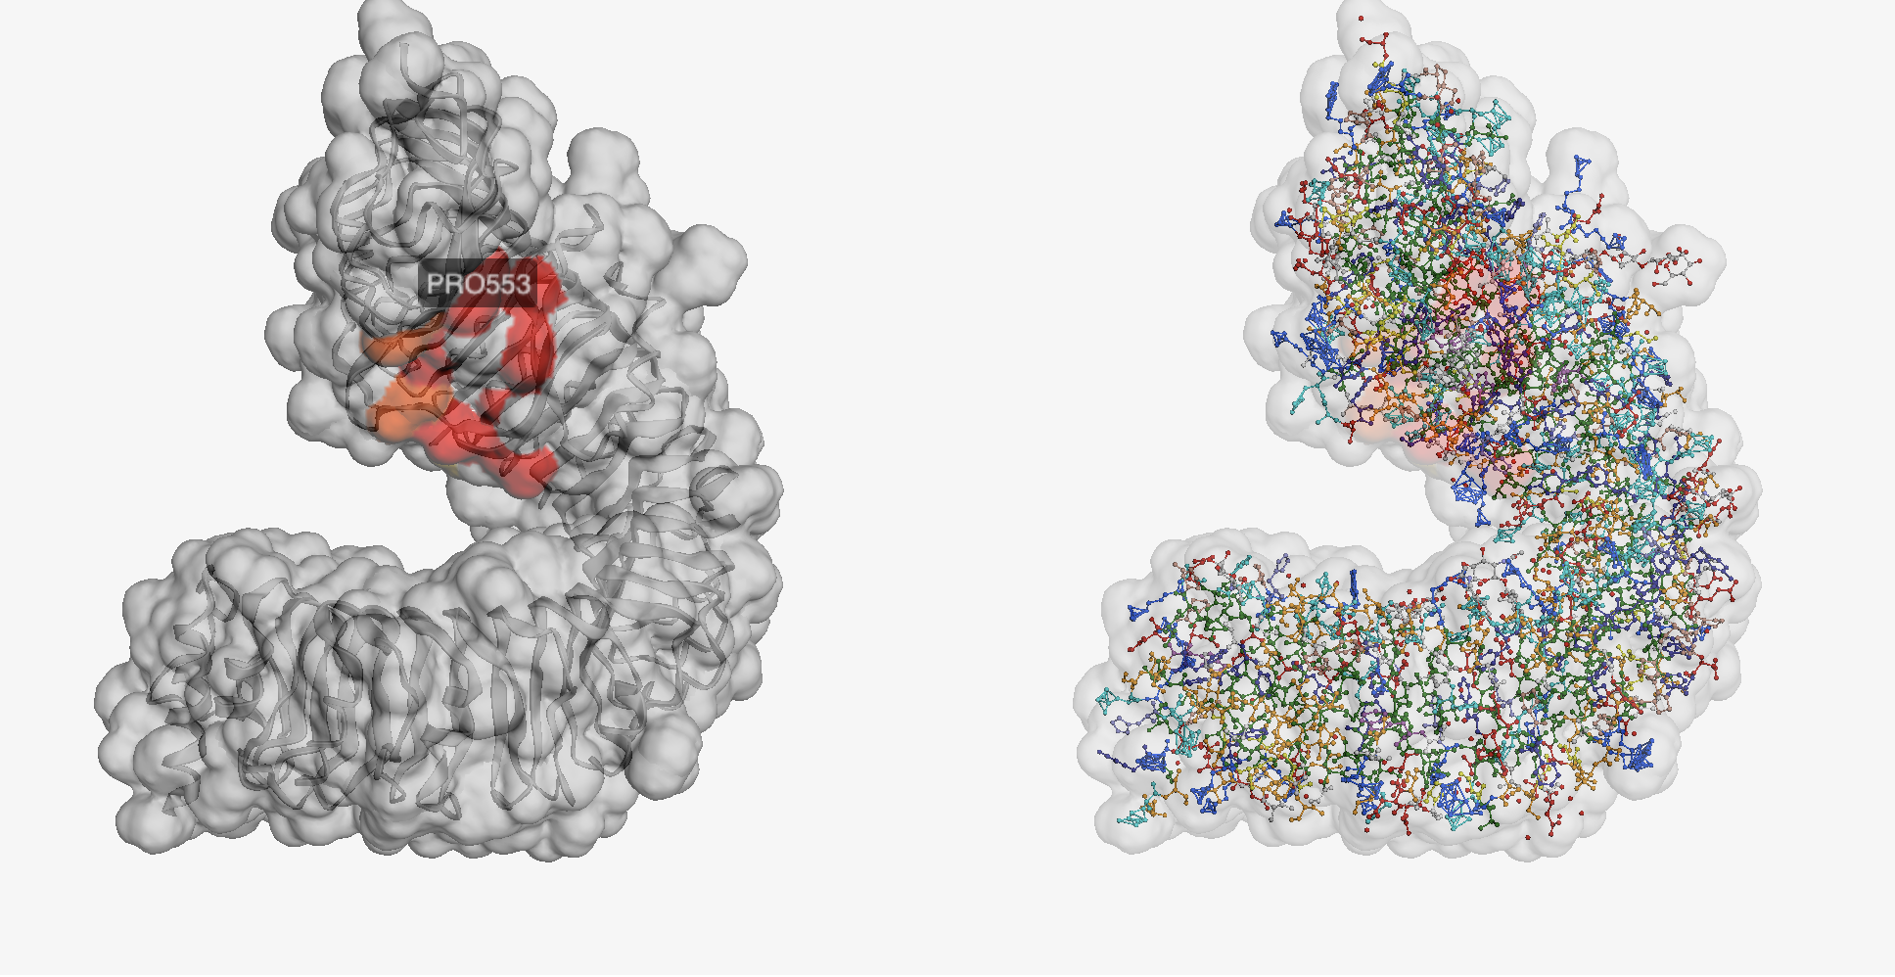
Heatmap Generation
3 riz-BLD docking
5gij-BLD docking

Slide 12
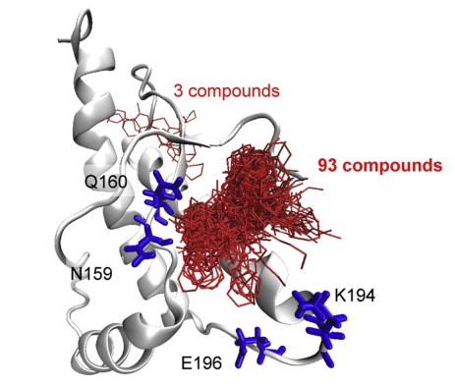
Prospective Studies
Future studies in this field requires different protein and ligand interaction investigation such as mutant protein interaction
These studies require consistent improvements and consistent updates due to new discoveries in how protein docking is done
Improved scoring functions
New models in docking protocol
Prion protein interaction with specific ligands
Figure illustrating prion-ligand interaction (Ishibashi et al 2016)

Slide 13
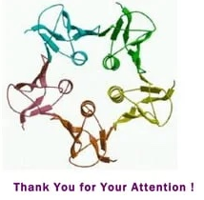

Slide 14
Reference
Ishibashi D, Nakagaki T, Ishikawa T, Atarashi R, Watanabe K, Cruz FA, Hamada T, Nishida N. 2016. Structure-based drug discovery for prion disease using a novel binding simulation. EBioMedicine. 9:238–249. doi:10.1016/j.ebiom.2016.06.010. http://dx.doi.org/10.1016/j.ebiom.2016.06.010.
Noresson A-L, Aurelius O, Öberg CT, Engström O, Sundin AP, Håkansson M, Stenström O, Akke M, Logan DT, Leffler H, et al. 2018. Designing interactions by control of protein–ligand complex conformation: tuning arginine–arene interaction geometry for enhanced electrostatic protein–ligand interactions. Chem Sci. 9(4):1014–1021. doi:10.1039/c7sc04749e. http://dx.doi.org/10.1039/c7sc04749e.
Padhorny D, Kazennov A, Zerbe BS, Porter KA, Xia B, Mottarella SE, Kholodov Y, Ritchie DW, Vajda S, Kozakov D. 2016. Protein–protein docking by fast generalized Fourier transforms on 5D rotational manifolds. Proc Natl Acad Sci U S A. 113(30):E4286–E4293. doi:10.1073/pnas.1603929113. http://dx.doi.org/10.1073/pnas.1603929113.
Ritchie DW. 2003. Evaluation of protein docking predictions using Hex 3.1 in CAPRI rounds 1 and 2. Proteins. 52(1):98–106. doi:10.1002/prot.10379. http://dx.doi.org/10.1002/prot.10379.
Tobi D, Bahar I. 2005. Structural changes involved in protein binding correlate with intrinsic motions of proteins in the unbound state. Proc Natl Acad Sci U S A. 102(52):18908–18913. doi:10.1073/pnas.0507603102. http://dx.doi.org/10.1073/pnas.0507603102.
Waese J, Fan J, Pasha A, Yu H, Fucile G, Shi R, Cumming M, Kelley LA, Sternberg MJ, Krishnakumar V, et al. 2017. EPlant: Visualizing and exploring multiple levels of data for hypothesis generation in plant biology. Plant Cell. 29(8):1806–1821. doi:10.1105/tpc.17.00073. http://dx.doi.org/10.1105/tpc.17.00073.
Schrödinger, L., & DeLano, W. (2020). PyMOL. Retrieved from http://www.pymol.org/pymol

